Slide 1
Linux File system Implementations

Slide 2
A Possible File System Layout
Superblock contains info about the fs (e.g. type of fs, number of blocks, …)
i-nodes contain info about files

Slide 3
Super block
Super block contains
Size of the file system
The number of free blocks
A list of free blocks available
The index of the next free block
Size of the inode list
The number of free i-nodes in the file system
The index of the next free i-node in the free inode-list
lock fields for the free block

Slide 4
Inode
Inode is the data structure that describes attributes of a file including the layout of its data on disk
contains the information necessary for a process to access a file
Contains the administrative information of a file
There are 2 versions of i-node
The disk copy that stores the inode information when the file is not in use
Incore copy that reads information of the active file

Slide 5
Inode structure
consists of
- file owner identifier
- file type
- file access permissions
- file access times
- number of links to the file
- table of contents for the disk address of data in a file
- file size

Slide 6
File data and i-node data
Note the distinction between the writing the contents of an i-node to disk and writing the contents of a file to disk.
The contents of a file changes only when writing it.
The contents of an i-node change when changing the contents of a file, or ownership or permission or link settings
Changing the contents of a file automatically implies a change to the i-node. But changing the i-node doesn’t imply that the contents of the file change

Slide 7
In-core inodes
In memory copy of i-node is called in-core inode
in-core copy of the inode contains
- status of the in-core inode
- locked or waiting
- logical device number of file system
- inode number
- pointers to other in-core inodes
- reference count

Slide 8
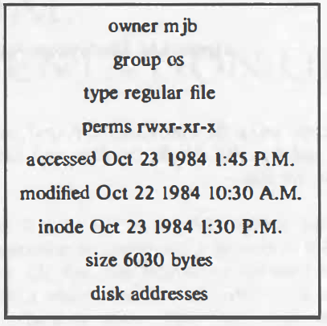
Sample disk i-node

Slide 9
Directories
Directories are files that give the file systems its hierarchical structure
They play an important role in conversion of a file name to an inode number
A directory is a file whose data is a sequence of entries, each consisting of an inode number and the name of a file contained in the directory

Slide 10
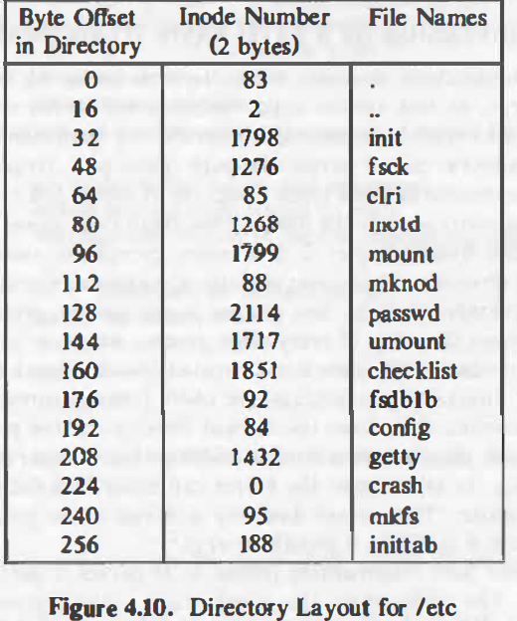
Directory layout for /etc

Slide 11
kernel Architecture (UNIX)
User program
Library
User level
system call interface
kernel level
File Subsystem
Inter process
communication
Buffer Cache
Process Control
Subsystem
Scheduler
Memory Management
character block
Device driver
Hardware control
kernel level
hardware
User level

Slide 12
Buffer cache
The kernel could read and write to and from the disk for all file access
System response time and throughput will be poor because of slow disk transfer rate
There for kernel attempts to minimize the frequency of the disk access by keeping a pool of internal data buffers
This buffers are called buffer cache.

Slide 13
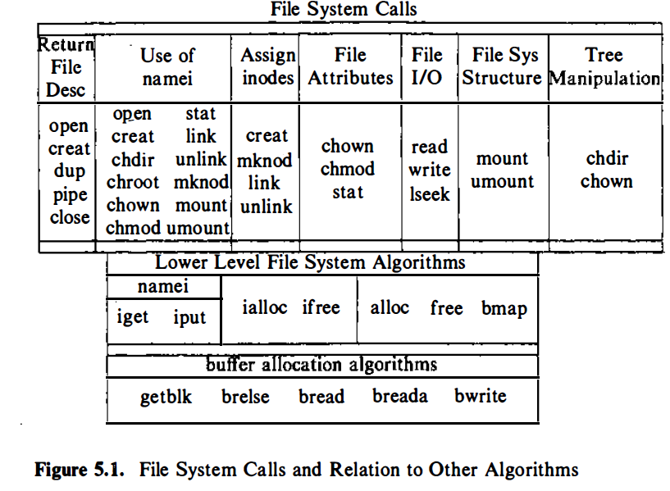

Slide 14
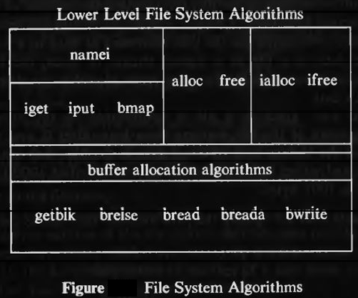
Low level file system algorithms in unix

Slide 15
Buffer allocation algorithm
Scenarios for retrieval of a buffer
The kernel identifies the block it needs by supplying the logical device number and block number.
For reading and writing disk blocks, we use the algorithm getblk to allocate buffers from the pool.
The getblk algorithm searches the buffer cache for a block and if the buffer is present, it locks the buffer and returns
If the block is not in the cache, kernel reassigns a free buffer to the block

Slide 16
bread and bwrite
The algorithm bread allocates a buffer for a block and reads the data into the buffer
The algorithm bwrite copies data into a block
breada is a variant of bread… block read-ahead algorithm

Slide 17
Low level file system algorithms in unix

Slide 18
File system algorithms
Algorithm ialloc & ifreee : assigns and removes a disk i-node to a newly created file.
Algorithm iget, iput : controls the allocation of in-core i-nodes when the process access a file.
Algorithm bmap : locates the disk blocks of a file.
Algorithm namei : converts the file names manipulated by process to inodes used internally by the kernel.
Algorithm alloc & free : allocates and remove a data block from a file system to a newly created file.

Slide 19
Accessing i-node
Algorithm iget allocates an incore copy of an i-node
Kernel maps the device number and inode number to search
If it cant be find, allocate a new one.
The kernel then prepares to read the disk copy of newly accessed inode to incore copy.

Slide 20
Conversion of a path name to an inode – namei algorithm
Kernel work internally with inodes rather than path names. it converts path name to inodes internally to access the file
The algorithm namei parses the pathname one component at a time, converting each component into an inode based on its names in the current directory and eventually returns inode of the input pathname.
If path name starts from root, then the kernel assigns root inode(iget) to working inode
Otherwise, the kernel assigns current directory (u area contains)inode to working inode
While there is more path name, the kernel reads next path name component from input, and verifies that working inode is of directory, access permissions OK
If working inode is of root and component is ‘..’, then the kernel checks whether there is more path name or not
Otherwise the kernel reads directory by repeated use of bmap,bread,brelse

Slide 21
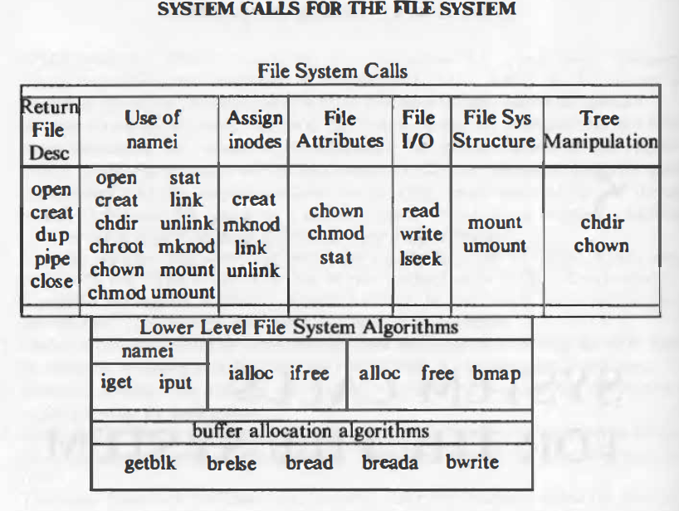
Super block
consists of
- the size of the file system
- the number of free blocks in the file system
- a list of free blocks available on the file system
- the index of the next free block in the free block list
- the size of the inode list
- the number of free inodes in the file system
- a list of free inodes in the file system
- the index of the next free inode in the free inode list
- lock fields for the free block and free inode lists
- a flag indicating that the super block has been modified

Slide 22

Open
Fd=open(pathname, flags, modes);
Pathname : file name
Flags : type of the open
Modes : file permission (esp for creat)
Returns an integer called the user file descriptor

Slide 23
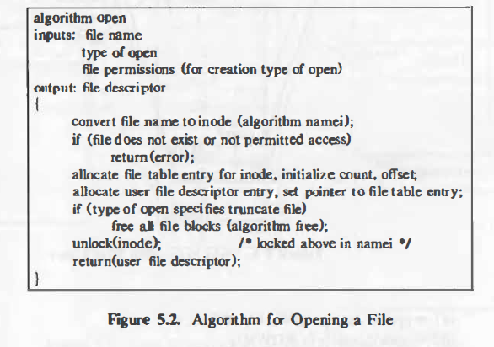
Algorithm for open

Slide 24
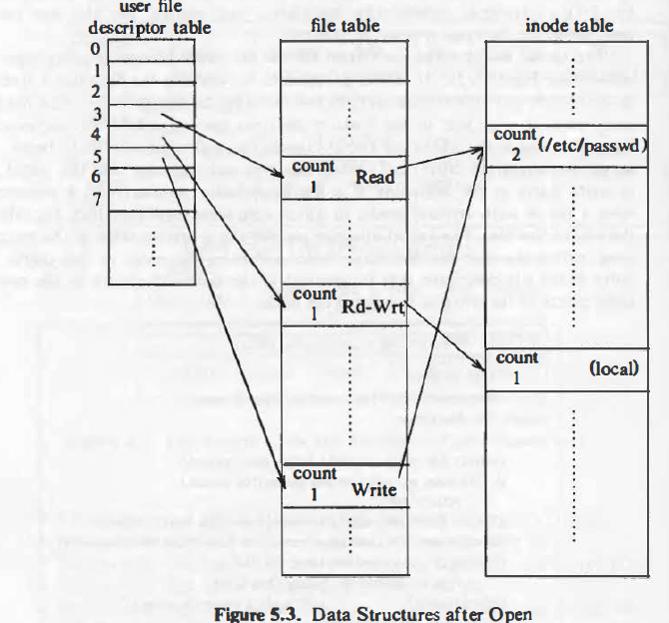
Data structures for open

Slide 25
Read
The syntax of the read system call is
number = read(fd, buffer, count)
-fd is the file descriptor returned by open
-buffer is the address of the data structure
-Count is the number of bytes the user wants to read
-number is the number of bytes actually read

Slide 26
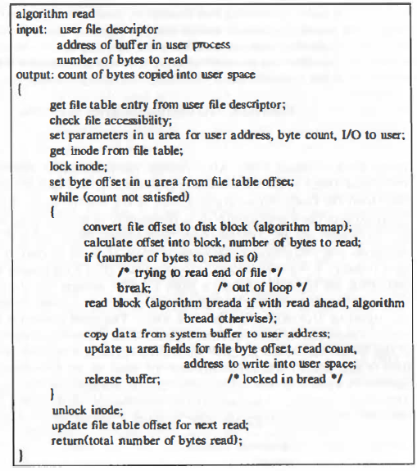

Slide 27
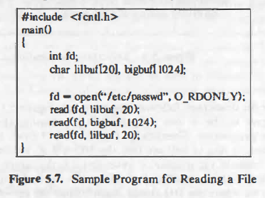

Slide 28
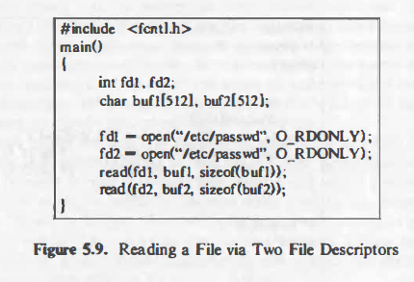

Slide 29
Write() system call
The syntax for the write system call is
number = write(fd, buffer, count);
where the meaning of the variables fd, buffer, count, and number are the same as they are for the read system call.
The algorithm for writing a regular file is similar
to that for reading a regular file.

Slide 30
Create()
the creat system call creates a new file in the system. The syntax for the creat system call is
fd - creat(pathname, modes) ;
where the variables pathname, modes, and fd mean the same as they do in the open system call.

Slide 31
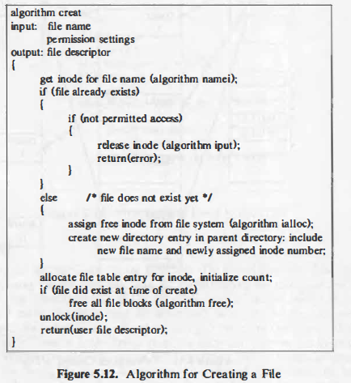

Slide 32
Close()
The syntax for the close system call is
close(fd);
where fd is the file descriptor for the open file.
The kernel does the close operation by manipulating the file descriptor and the corresponding file table and inode table entries. If the reference count of the file table entry is greater than 1

Slide 33
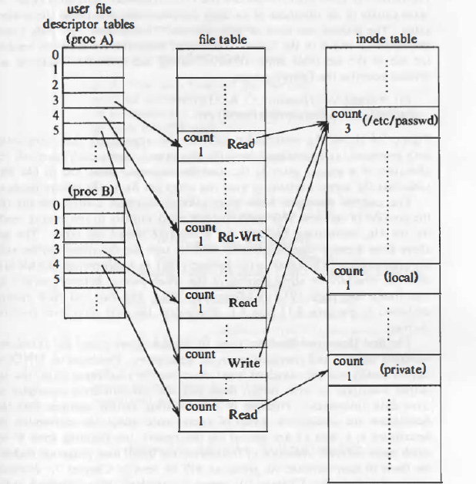
Process B: fd1= open(''/etc/passwd", O_RDONLY); fd2 ,.,. open("private", O_RDONLY);
Process A:

Slide 34
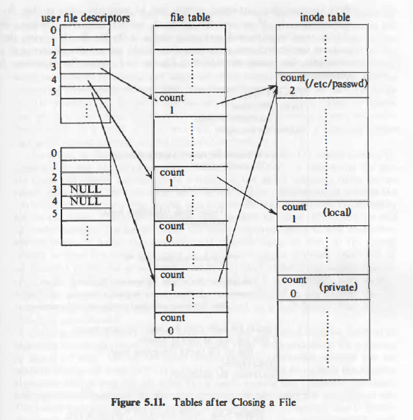
Tables after closing a file

Slide 35
Cp program

Slide 36
Cp …

